Slide 1
Database Management System (MDS 505)
Jagdish Bhatta
Jagdish Bhatta

Slide 2
Unit-1
Fundamental Concept of DBMS:ER Model
Jagdish Bhatta
Notes:
Jagidsh Bhatta

Slide 3
High-Level Conceptual Data Models for Database Design
Precise Database:
Need to come up with a methodology to ensure that each of the relations in the database is “good”, “complete” and “precise”.
Two ways of doing so:
  Entity Relationship Model
    Models an enterprise as a collection of entities and relationships
    Represented diagrammatically by an entity-relationship diagram:
  Normalization Theory
    Formalize what designs are bad, and test for them

Slide 4
High-Level Conceptual Data Models for Database Design
Database Design Considerations:
  Data Constraints and Relational Database Design
  Usage Requirements: Queries, Performance
    Throughput, Response Time
  Authorization Requirements
  Data Flow

Slide 5
Database Design Considerations
Be aware about avoiding:
  Redundancy
  Incompleteness

Slide 6
Entities Relationship Model
The entity-relationship (E-R) model is a high level data model based on a perception of a real world that consists of collection of basic objects, called entities, and of relationships among these entities. An entity is a thing or object in the real world that is distinguishable from other objects.
Entities are described in a database by a set of attributes. A relationship is an association among several entities. The set of all entities of the same type is called an entity set and the set of all relationships of the same type is called a relationship set.
ER Model is logical modeling of a database.
Jagdish Bhatta
Notes:
Jagidsh Bhatta

Slide 7
Entities and Attributes
Entity is a thing in real world with and independent existence that is distinguishable from all other objects. An Entity may be an object with physical existence like person, vehicle etc. or may be an object with conceptual existence like account, course etc.
Each entities have certain kind of properties that gives proper identification to each of entity. Thus, attributes are the properties that describe the entity. Each entity has value for each of its attributes. Thus, for each attribute there is a set of permitted values known as Domain. Hence attribute of an entity set can be defined as a function that maps from the entity set to a domain. Example:
    Entity:- Employee
    Attributes:- Employee_id, Name, Salary, Age, Phone
    An instance of entity Employee will be defined once certain values will be assigned to the given attributes.
Jagdish Bhatta
Notes:
Jagidsh Bhatta

Slide 8

ER Diagram: An Example
Jagdish Bhatta
Jagdish Bhatta
Notes:
Jagidsh Bhatta
Jagidsh Bhatta

Slide 9
Attribute Types…..
Attributes can be of following types;
    Simple vs. Composite
    Single Valued vs. Multi-valued
    Stored vs. Derived
    Null Valued
    Complex
Simple Vs. Composite:-
  Simple are those that are not divisible. They are also known as “atomic attributes”.
  Composite attributes are those that are made up of one or more simple or composite attributes & hence are divisible to smaller subparts. Composite attributes can form a hierarchy.
  Eg: Address can be the composite attribute as it can be subdivided into Streetaddress, City, State.
  Similarly, Name can be divided as Fname, Lname. But Fname, Lname themselves are simple.
Jagdish Bhatta
Notes:
Jagidsh Bhatta

Slide 10
Attribute Types…..
Single Valued vs. Multi-valued:-
  Single valued are those having just a single value, for a particular entity, from the permitted domain.
  Multi-valued are those that can have a set of values for same entity.
  Eg: Roll_no, age can be considered as single valued. While Phone_no, College_degree can have multiple values, so are multivalued.
Stored vs. Derived:-
  An attribute whose value can be derived from or inferred from the value of another attribute, then it is derived otherwise it is stored. For example, Age attribute is derived as it can be inferred from the Date_of_birth attribute which is stored.
Null Valued:-
  Are those attributes that do not have any applicable values. The null values can also be used if we do not know the value of an attribute for a particular entity.
Jagdish Bhatta
Notes:
Jagidsh Bhatta

Slide 11
Attribute Types…..
Complex:-
  Composite and multivalued attributes can be nested arbitrarily. We can represent arbitrary nesting by grouping components of a composite attribute between parentheses ( ) and separating the components with commas, and by displaying multivalued attributes between braces { }. Such attributes are called complex attributes. For example, if a person can have more than one residence and each residence can have a single address and multiple phones, an attribute Address_phone for a person. Both phone and address themselves are composite attributes.
    {Address_phone ({Phone(Area_code,Phone_number)}, Address(Street_address (Number,Street,Apartment_number),City,State,Zip))}
Jagdish Bhatta
Notes:
Jagidsh Bhatta

Slide 12
Entities types and Entity sets
Entity Types: Entity type defines a collection of entities that have same attributes, but each entity has its own value for each attributes. An entity type describes the schema for a set of entities that share same structure. Each entity type in the database is described by its name and attributes. An entity type describes the schema or intension for a set of entities that share the same structure.
Entity Sets: An entity set is a set of entities of the same type that share the same properties, or attributes i.e. the collection of all the entities of particular type in the database at any instance is called the entity set or entity collection. The entity set is usually referred to using the same name as entity type.
In the process of modeling, we often use the term entity set in the abstract, without referring to a particular set of individual entities. We use the term extension of the entity set to refer to the actual collection of entities belonging to the entity set. The actual instances of employee form extension of the entity employee.
Jagdish Bhatta
Notes:
Jagidsh Bhatta

Slide 13
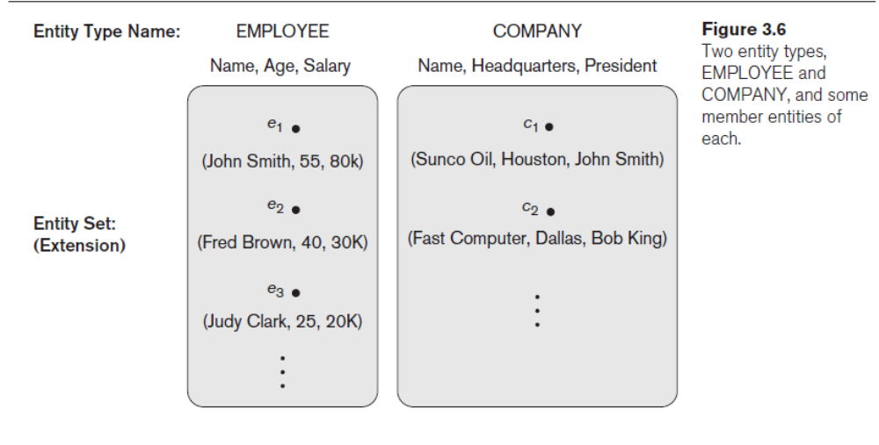
Entities types and Entity sets
Example:
e4
( John Smith, 55, 80k}
Jagdish Bhatta
Notes:
Jagidsh Bhatta

Slide 14
Key Attributes of Entity Types
An important constraint on the entities of an entity type is the key or uniqueness constraint on attributes. An entity type usually has one or more attributes whose values are distinct for each individual entity in the entity set. Such an attribute is called a key attribute, and its values can be used to identify each entity uniquely.
Sometimes several attributes together form a key, meaning that the combination of the attribute values must be distinct for each entity. If a set of attributes possesses this property, the proper way to represent this in the ER model that we describe here is to define a composite attribute and designate it as a key attribute of the entity type. Notice that such a composite key must be minimal; that is, all component attributes must be included in the composite attribute to have the uniqueness property.
Jagdish Bhatta
Notes:
Jagidsh Bhatta

Slide 15
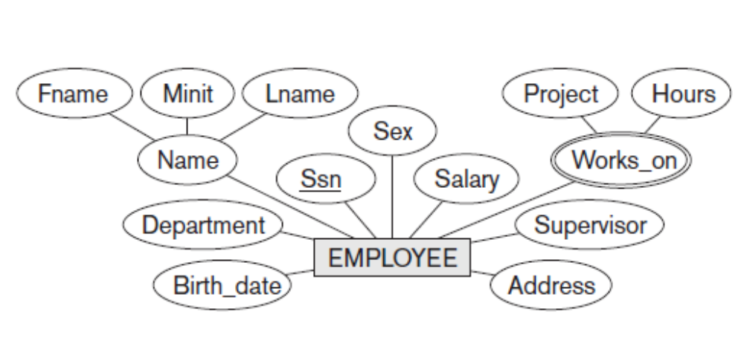
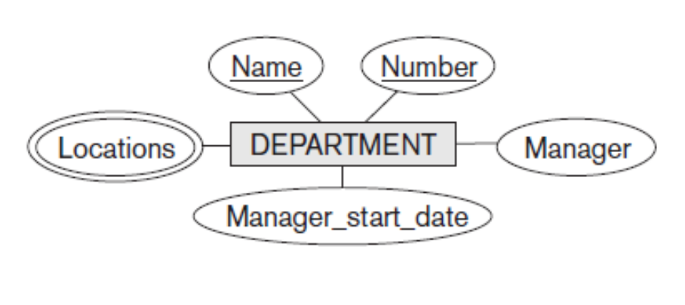
Keys Attributes of Entity Types
In the entity employee, Ssn is the primary key attribute.
In the entity Department, both Name and Number are the primary key attributes.
Jagdish Bhatta
Notes:
Jagidsh Bhatta

Slide 16
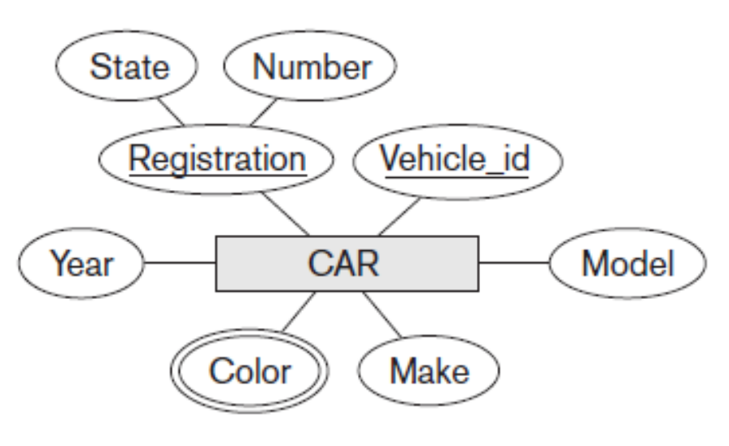
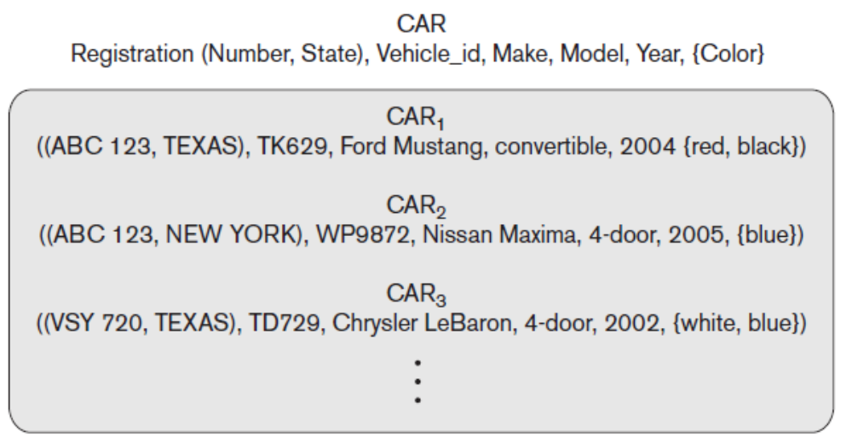
Keys Attributes of Entity Types
In the entity Car, registration and vehichle_id are the primary key attributes. The Registration attribute is an example of a composite key formed from two simple component attributes, State and Number, neither of which is a key on its own.
The CAR entity type CAR entity set with three entities.
Jagdish Bhatta
Notes:
Jagidsh Bhatta

Slide 17
Value Sets (Domains) of Attributes
Value Sets (Domains) of Attributes. Each simple attribute of an entity type is associated with a value set (or domain of values), which specifies the set of values that may be assigned to that attribute for each individual entity. Value sets are not typically displayed in basic ER diagrams and are similar to the basic data types available in most programming languages, such as integer, string, Boolean, float, and so on.
Mathematically, an attribute A of entity set E whose value set is V can be defined as a function from E to the power set P(V) of V:
A : E → P(V)
Jagdish Bhatta
Notes:
Jagidsh Bhatta

Slide 18
Value Sets (Domains) of Attributes
In Figure 3.6, if the range of ages allowed for employees is between 16 and 70, we can specify the value set of the Age attribute of EMPLOYEE to be the set of integer numbers between 16 and 70. Similarly, we can specify the value set for the Name attribute to be the set of strings of alphabetic characters separated by blank characters, and so on.
Jagdish Bhatta
Notes:
Jagidsh Bhatta

Slide 19
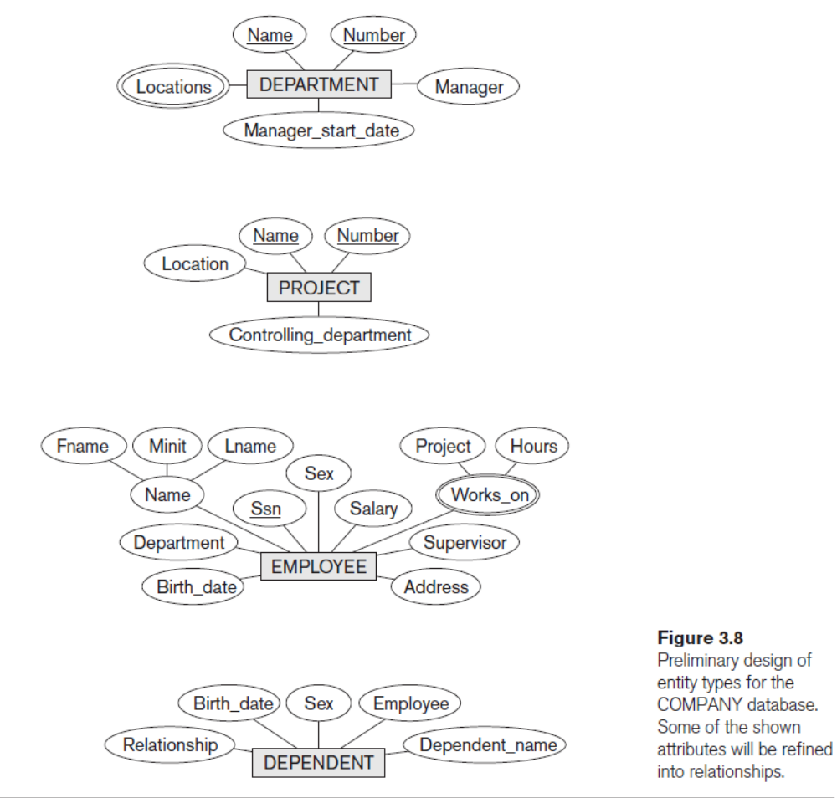
Jagdish Bhatta
Notes:
Jagidsh Bhatta

Slide 20
ER Diagram: An Example
Jagdish Bhatta
Jagdish Bhatta
Notes:
Jagidsh Bhatta
Jagidsh Bhatta

Slide 21
Relationship Types, Relationship Sets, Roles
Relationship is an association among several entities.
Relationships can be thought of as verbs, linking two or more nouns. Examples: a teaches relationship between a teacher and a student, a supervises relationship between an employee and a department etc.
Jagdish Bhatta
Jagdish Bhatta
Notes:
Jagidsh Bhatta
Jagidsh Bhatta

Slide 22
Relationship Types, Relationship Sets, Roles
A relationship type R among n entity types E1, E2, . . . , En defines a set of associations— or a relationship set—among entities from these entity types. Similar to the case of entity types and entity sets, a relationship type and its corresponding relationship set are customarily referred to by the same name, R. Mathematically, the relationship set R is a set of relationship instances ri, where each ri associates n individual entities (e1, e2, . . . , en), and each entity ej in ri is a member of entity set Ej, 1 ≤ j ≤ n. Hence, a relationship set is a mathematical relation on E1, E2, . . . , En; alternatively, it can be defined as a subset of the Cartesian product of the entity sets E1 × E2 × . . . × En. Each of the entity types E1, E2, . . . , En is said to participate in the relationship type R; similarly, each of the individual entities e1, e2, . . . , en is said to participate in the relationship instance ri = (e1, e2, . . . , en).
Jagdish Bhatta
Jagdish Bhatta
Notes:
Jagidsh Bhatta
Jagidsh Bhatta

Slide 23
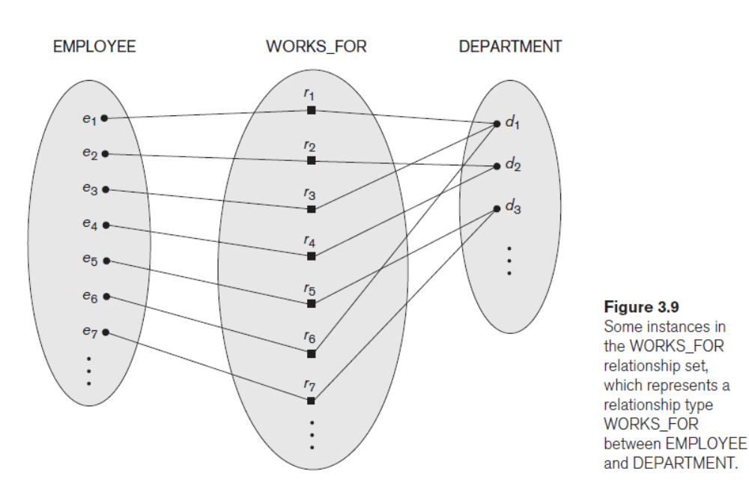
Relationship Types, Relationship Sets, Roles
Jagdish Bhatta
Jagdish Bhatta
Notes:
Jagidsh Bhatta
Jagidsh Bhatta

Slide 24
Relationship Types, Relationship Sets, Roles
Degree of relationship type:- The degree of relationship type is the number of participating entity types. Relationships can generally be of any degree, but the most common ones are binary relationships. i.e. having two participating entity types.
having three participating entity types - Ternary relationship
having n participating entity types – n-ary relationship
The function that an entity plays in a relationship is called its role. Roles are normally explicit and not specified. They are useful when the meaning of a relationship set needs clarification. The role name signifies the role that a participating entity from the entity type plays in each relationship instance, and it helps to explain what the relationship means.
When some entity type participates more than once in a relationship type in different roles, then we term it as a recursive relationship or Self-Referencing.
Jagdish Bhatta
Jagdish Bhatta
Notes:
Jagidsh Bhatta
Jagidsh Bhatta

Slide 25
Relationship Types, Relationship Sets, Roles
Department
Employee
employer
Role
Names
Recursive
Relationship
Supervisor
Works_In
Subordinate
worker
Supervises
Employee
Fig 1: Role Names Fig 2: Recursive Relationship
The relationship in Fig. 1 has degree 2, so a binary relationship. While in Fig. 2 the degree is 1, so a unary relationship.
Jagdish Bhatta
Jagdish Bhatta
Notes:
Jagidsh Bhatta
Jagidsh Bhatta

Slide 26
Constraints on Binary Relationship Types (Mapping / Structural Constraints)
Relationship types have certain constraints that limit the set of possible combination of entities that may participate in the relationship type. There are mainly two types of constraints;
  Cardinality Ratio
  Participation Constraint
Cardinality Ratio:- It specifies the maximum number of relationship instances that an entity can participate in.
In other words, it defines how many entities of an entity set participate in a relationship type.
Or, it express the number of entities to which another entity can be associated via a relationship set.
Possible cardinality ratios for binary relationship types are:
- One to one; One to many; Many to one; Many to many
Jagdish Bhatta
Jagdish Bhatta
Notes:
Jagidsh Bhatta
Jagidsh Bhatta

Slide 27
Mapping Constraints (Contd…..)
If R is a relationship set between two entity sets A and B, then cardinality ratio can be defined as;
One to One:- An entity in A is associated with at most one entity in B and an entity in B is associated with at most one entity in A.
One to Many:- An entity in A is associated with any number of entities in B, while an entity in B can be associated with at most one entity in A.
Many to One:- An entity in A is associated with at most one entity in B, while an entity in B can be associated with any number of entities in A.
Many to Many:- An entity in A can be associated with any number of entities in B and an entity in B can be associated with any number of entities in A.
Jagdish Bhatta
Jagdish Bhatta
Notes:
Jagidsh Bhatta
Jagidsh Bhatta

Slide 28


Mapping Constraints (Contd…..)
EXAMPLES :
  relationship set HAS from Department to Chairperson is one-to-one.
  relationship set TEACHES from Teacher to Student is one-to-many & TAUGHT_BY from Student to Teacher is many-to-one.
  relationship set STUDY from Student to Course is many-to-many .
One to one
One to many
Many to one
Many to many
Jagdish Bhatta
Jagdish Bhatta
Notes:
Jagidsh Bhatta
Jagidsh Bhatta

Slide 29
Constraints on Binary Relationship Types (Mapping/Structural Constraints)
Participation Constraint:- It describes the whether existence of an entity depends on another entity to which it is related through a relationship type
It specifies the minimum number of relationship instances that each entity can participate in, and is sometimes called the minimum cardinality constraint. It may be;
  Total Participation(Existence Dependency)
  Partial participation
Total participation:- The participation of an entity set E in a relationship set R is said to be total if each entity in E participates in at least one relationship in R i.e. each entity depends upon existence of the related entity.
Consider Employee and Department entity sets, and a relationship WORKS_FOR between them indicating each employee must work for a department. Then there is total participation of entities from Employee entity set.
Jagdish Bhatta
Jagdish Bhatta
Notes:
Jagidsh Bhatta
Jagidsh Bhatta

Slide 30
Constraints on Relationship Types (Mapping Constraints)
Partial participation:- The participation of an entity set E in a relationship set R is said to be partial if only some entities in E participate in the relationships in R.
Consider Employee and Department entity sets, and a relationship MANAGES between them indicating some employees manages department. Then there is partial participation of entities from Employee entity set.
Employee
Department
Employee
Department
.
.
.
.
.
.
.
.
.
.
.
.
.
.
WORKS_FOR
MANAGES
Total Participation
Partial Participation
Jagdish Bhatta
Jagdish Bhatta
Notes:
Jagidsh Bhatta
Jagidsh Bhatta

Slide 31
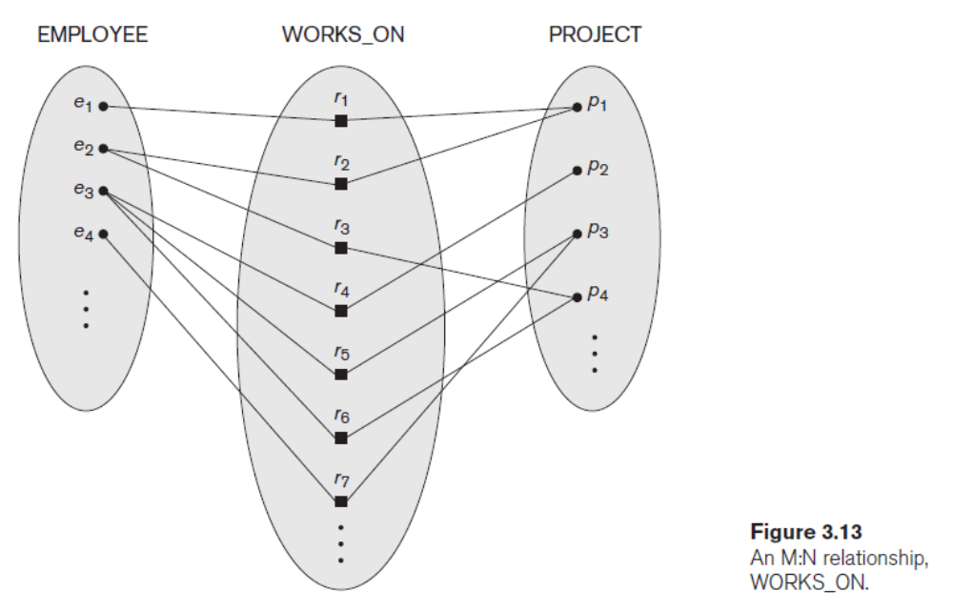
Attributes of Relationship Types
Relationship types can also have attributes, similar to those of entity types and are often known as descriptive attributes. For example, to record the number of hours per week that a particular employee works on a particular project, we can include an attribute Hours for the WORKS_ON relationship type in Figure 3.13.
Jagdish Bhatta
Jagdish Bhatta
Notes:
Jagidsh Bhatta
Jagidsh Bhatta

Slide 32
Attributes of Relationship Types
Attributes of 1:1 relationship types can be migrated to one of the participating entity types.
For a 1:N relationship type, a relationship attribute can be migrated only to the entity type on the N-side of the relationship.
For M:N (many-to-many) relationship types, some attributes may be determined by the combination of participating entities in a relationship instance, not by any single entity. Such attributes must be specified as relationship attributes.
Jagdish Bhatta
Jagdish Bhatta
Notes:
Jagidsh Bhatta
Jagidsh Bhatta

Slide 33
Weak Entity Types
Entity types that do not have key attributes of their own are called weak entity types. In contrast, regular entity types that do have a key attribute—which include all the examples discussed so far—are called strong entity types. Entities belonging to a weak entity type are identified by being related to specific entities from another entity type in combination with one of their attribute values. We call this other entity type the identifying or owner entity type, and we call the relationship type that relates a weak entity type to its owner the identifying relationship of the weak entity type.
A weak entity type always has a total participation constraint (existence dependency) with respect to its identifying relationship because a weak entity cannot be identified without an owner entity. However, not every existence dependency results in a weak entity type. For example, a DRIVER_LICENSE entity cannot exist unless it is related to a PERSON entity, even though it has its own key (License_number) and hence is not a weak entity.
Jagdish Bhatta
Jagdish Bhatta
Notes:
Jagidsh Bhatta
Jagidsh Bhatta

Slide 34
Weak Entity Types
A weak entity type normally has a partial key, which is the attribute that can uniquely identify weak entities that are related to the same owner entity.
In ER diagrams, both a weak entity type and its identifying relationship are distinguished by surrounding their boxes and diamonds with double lines. The partial key attribute is underlined with a dashed or dotted line.
Weak entity types can sometimes be represented as complex (composite, multivalued) attributes. The choice of which representation to use is made by the database designer.
A weak entity type may have more than one identifying entity type and an identifying relationship type of degree higher than two.
The identifying relationship is many-to-one from the weak entity set to the identifying entity set
Jagdish Bhatta
Jagdish Bhatta
Notes:
Jagidsh Bhatta
Jagidsh Bhatta

Slide 35
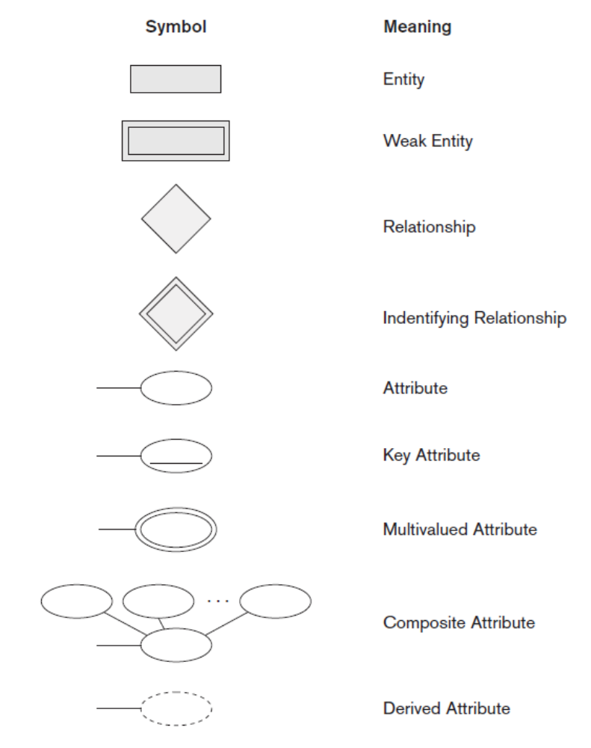
ER Diagram Notations
ER- Notations:
Jagdish Bhatta
Jagdish Bhatta
Notes:
Jagidsh Bhatta
Jagidsh Bhatta

Slide 36
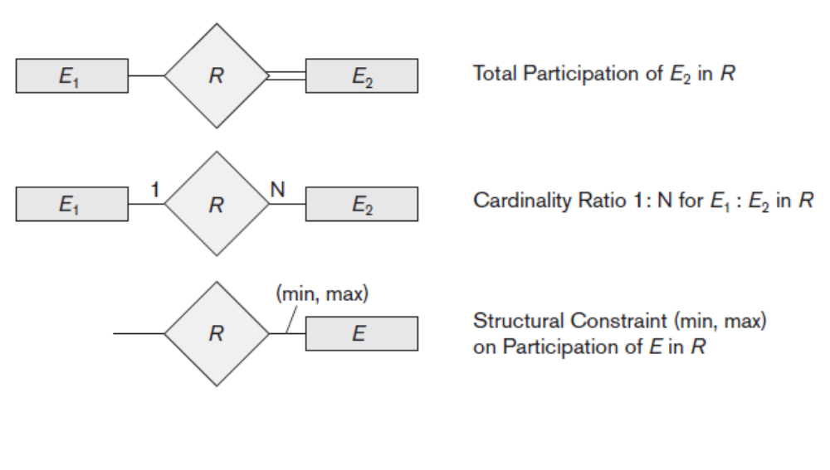
ER Diagram Notations
ER- Notations:
Jagdish Bhatta
Jagdish Bhatta
Notes:
Jagidsh Bhatta
Jagidsh Bhatta

Slide 37
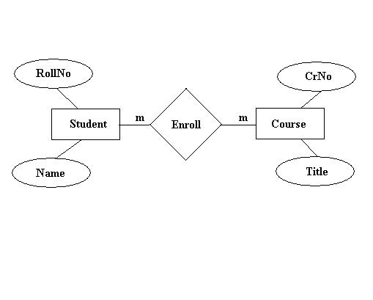
ER Diagram: An Example
Jagdish Bhatta
Jagdish Bhatta
Notes:
Jagidsh Bhatta
Jagidsh Bhatta

Slide 38
ER Diagram: An Example
Jagdish Bhatta
Jagdish Bhatta
Notes:
Jagidsh Bhatta
Jagidsh Bhatta

Slide 39
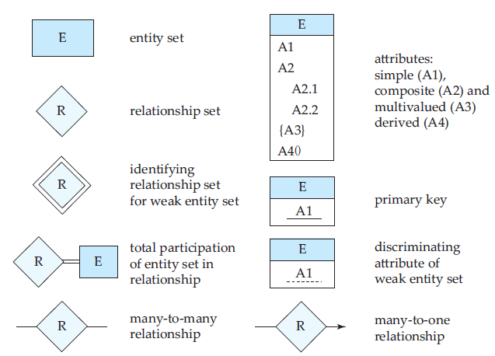
ER Diagram Notations: Based on Silberschatz Book
Jagdish Bhatta
Jagdish Bhatta
Notes:
Jagidsh Bhatta
Jagidsh Bhatta

Slide 40
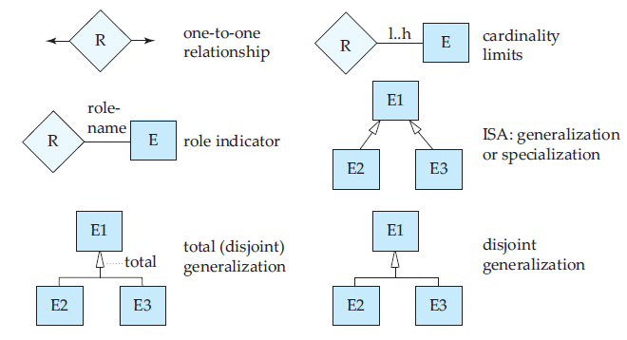
ER Diagram Notations: ….
Jagdish Bhatta
Jagdish Bhatta
Notes:
Jagidsh Bhatta
Jagidsh Bhatta

Slide 41
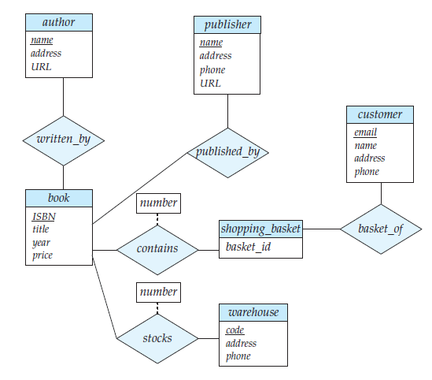
ER Diagram Notations: ….
Descriptive
Attributes
Jagdish Bhatta
Jagdish Bhatta
Notes:
Jagidsh Bhatta
Jagidsh Bhatta

Slide 42
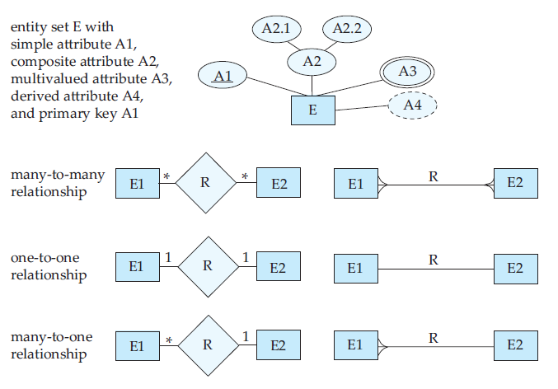
ER Diagram Notations: ….
Jagdish Bhatta
Jagdish Bhatta
Notes:
Jagidsh Bhatta
Jagidsh Bhatta

Slide 43
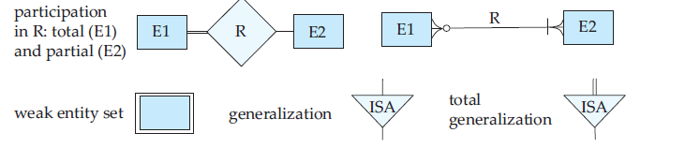
ER Diagram Notations: ….
Jagdish Bhatta
Jagdish Bhatta
Notes:
Jagidsh Bhatta
Jagidsh Bhatta

Slide 44
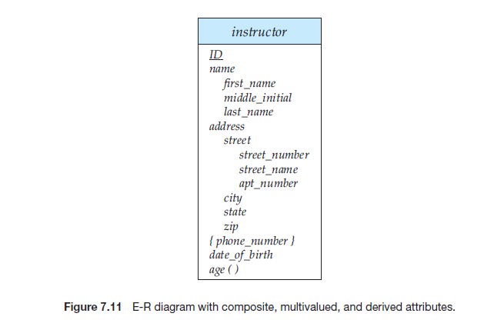
ER Diagram Notations: ….
Jagdish Bhatta
Jagdish Bhatta
Notes:
Jagidsh Bhatta
Jagidsh Bhatta

Slide 45
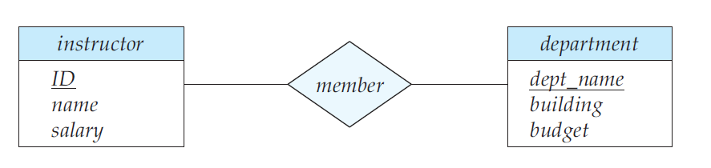
ER Diagram Notations: ….
Jagdish Bhatta
Jagdish Bhatta
Notes:
Jagidsh Bhatta
Jagidsh Bhatta

Slide 46
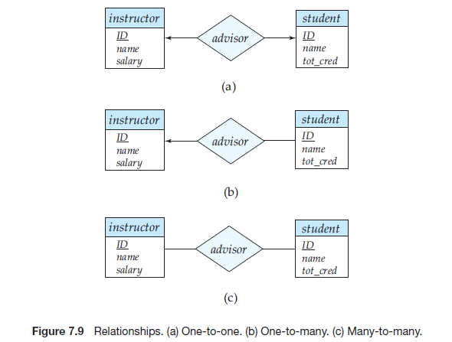
ER Diagram Notations: ….
Jagdish Bhatta
Jagdish Bhatta
Notes:
Jagidsh Bhatta
Jagidsh Bhatta

Slide 47
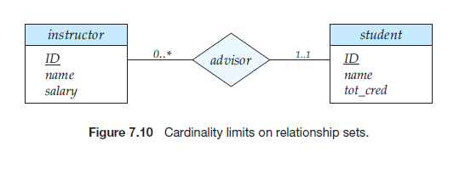
ER Diagram Notations: ….
Jagdish Bhatta
Jagdish Bhatta
Notes:
Jagidsh Bhatta
Jagidsh Bhatta

Slide 48
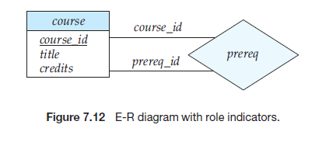
ER Diagram Notations: ….
Roles
Jagdish Bhatta
Jagdish Bhatta
Notes:
Jagidsh Bhatta
Jagidsh Bhatta

Slide 49
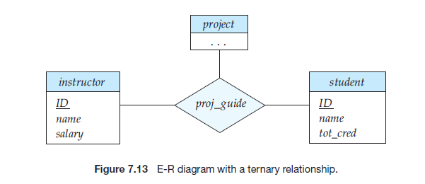
ER Diagram Notations: ….
Jagdish Bhatta
Jagdish Bhatta
Notes:
Jagidsh Bhatta
Jagidsh Bhatta

Slide 50
Weak Entity Example
Here departure is a weak entity type. Even though each departure entity is distinct but different flights may have departure on same date. Thus it can be identified by relating with owner entity type “flight”, since for each flight fight_no is unique.
Departure_time
Arrival_time
Date
Source
Flight
Instance _of
Departure
Destination
Flight_no
Jagdish Bhatta
Jagdish Bhatta
Notes:
Jagidsh Bhatta
Jagidsh Bhatta

Slide 51
Weak Entity…
Partial Key: A set of attributes that can uniquely identify weak entities that are related to the same owner entity. It is often known as discriminator.
In the previous example;
  {date} is a partial key.
  {flight_no, date} becomes the primary key for the Departure entity.
The entity types that do have key attributes of their own are called strong or regular entity types. They have their independent existence.
Jagdish Bhatta
Jagdish Bhatta
Notes:
Jagidsh Bhatta
Jagidsh Bhatta

Slide 52
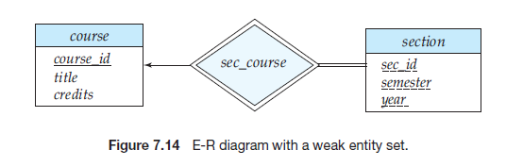
Weak Entity…
Jagdish Bhatta
Jagdish Bhatta
Notes:
Jagidsh Bhatta
Jagidsh Bhatta

Slide 53
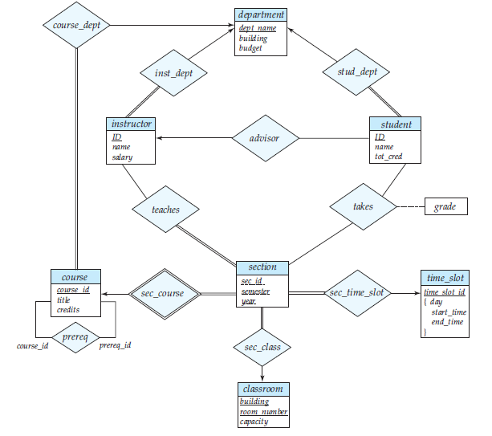
ER Diagram for University
Jagdish Bhatta
Jagdish Bhatta
Notes:
Jagidsh Bhatta
Jagidsh Bhatta

Slide 54
ER Diagram for Insurance Company
Construct an E-R diagram for a car insurance company whose customers own one or more cars each. Each car has associated with it zero to any number of recorded accidents. Each insurance policy covers one or more cars, and has one or more premium payments associated with it. Each payment is for a particular period of time, and has an associated due date, and the date when the payment was received.
Jagdish Bhatta
Jagdish Bhatta
Notes:
Jagidsh Bhatta
Jagidsh Bhatta

Slide 55
ER Diagram: Naming Convention
When designing a database schema, the choice of names for entity types, attributes, relationship types, and (particularly) roles is not always straightforward. One should choose names that convey, as much as possible, the meanings attached to the different constructs in the schema.
Choose singular names for entity types, rather than plural ones, because the entity type name applies to each individual entity belonging to that entity type.
In ER diagrams, it is good to use the convention that entity type and relationship type names are in uppercase letters, attribute names have their initial letter capitalized, and role names are in lowercase letters.
Jagdish Bhatta
Jagdish Bhatta
Notes:
Jagidsh Bhatta
Jagidsh Bhatta

Slide 56
ER Diagram: Naming Convention
As a general practice, given a narrative description of the database requirements, the nouns appearing in the narrative tend to give rise to entity type names, and the verbs tend to indicate names of relationship types. Attribute names generally arise from additional nouns that describe the nouns corresponding to entity types.
Another naming consideration involves choosing binary relationship names to make the ER diagram of the schema readable from left to right and from top to bottom
Jagdish Bhatta
Jagdish Bhatta
Notes:
Jagidsh Bhatta
Jagidsh Bhatta

Slide 57
Design Choices for ER Conceptual Design
It is occasionally difficult to decide whether a particular concept should be modeled as an entity type, an attribute, or a relationship type.
In general, the schema design process should be considered an iterative refinement process, where an initial design is created and then iteratively refined until the most suitable design is reached.
A concept may be first modeled as an attribute and then refined into a relationship because it is determined that the attribute is a reference to another entity type. It is often the case that a pair of such attributes that are inverses of one another are refined into a binary relationship. Once an attribute is replaced by a relationship, the attribute itself should be removed from the entity type to avoid duplication and redundancy.
Jagdish Bhatta
Jagdish Bhatta
Notes:
Jagidsh Bhatta
Jagidsh Bhatta

Slide 58
Design Choices for ER Conceptual Design
Similarly, an attribute that exists in several entity types may be elevated or promoted to an independent entity type. For example, suppose that each of several entity types in a UNIVERSITY database, such as STUDENT, INSTRUCTOR, and COURSE, has an attribute Department in the initial design; the designer may then choose to create an entity type DEPARTMENT with a single attribute Dept_name and relate it to the three entity types (STUDENT, INSTRUCTOR, and COURSE) via appropriate relationships. Other attributes/relationships of DEPARTMENT may be discovered later.
An inverse refinement to the previous case may be applied—for example, if an entity type DEPARTMENT exists in the initial design with a single attribute Dept_name and is related to only one other entity type, STUDENT. In this case, DEPARTMENT may be reduced or demoted to an attribute of STUDENT
Jagdish Bhatta
Jagdish Bhatta
Notes:
Jagidsh Bhatta
Jagidsh Bhatta

Slide 59
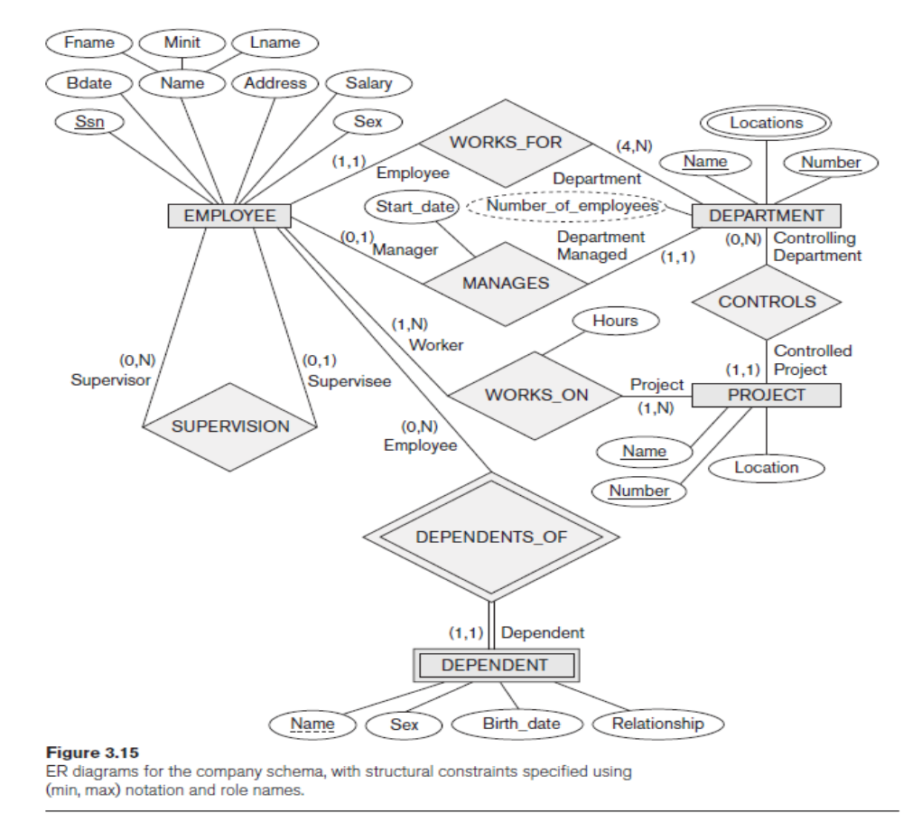
Jagdish Bhatta
Jagdish Bhatta
Notes:
Jagidsh Bhatta
Jagidsh Bhatta

Slide 60
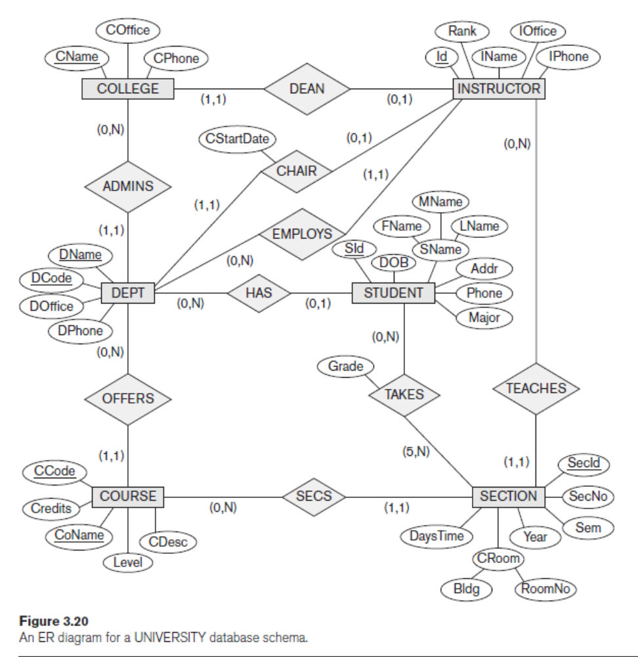
Jagdish Bhatta
Jagdish Bhatta
Notes:
Jagidsh Bhatta
Jagidsh Bhatta

Slide 61

Relationship Types of Degree Higher than Two
We defined the degree of a relationship type as the number of participating entity types and called a relationship type of degree two binary and a relationship type of degree three ternary.
Fig: A Ternary relationship
Jagdish Bhatta
Jagdish Bhatta
Notes:
Jagidsh Bhatta
Jagidsh Bhatta

Slide 62
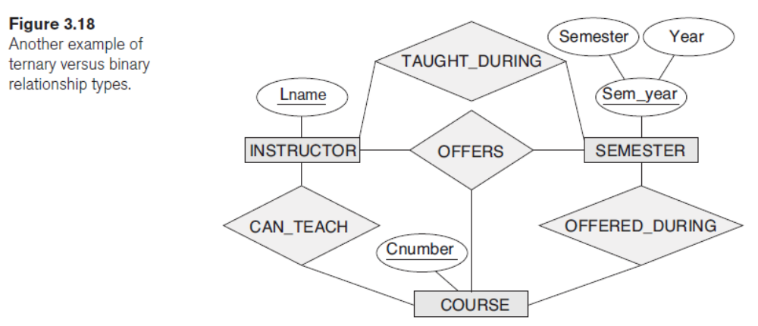
Relationship Types of Degree Higher than Two
Jagdish Bhatta
Jagdish Bhatta
Notes:
Jagidsh Bhatta
Jagidsh Bhatta

